Slide 1
Climate Study for the United States
Team 10
Member: Fan Wang, Pengkun Li, Aman Goyal
GitHub: https://github.com/WFighter909/ECE-143-Group-10
Notes:
Good Evening everybody,
Fan, Pengkun and I are going to present our project entitled Climate Study for the United States.

Slide 2
CONTENTS
Introduction
Data Collection and Preprocessing
Comparison between West and East Coast
Data Visualization of San Diego
Evaluations and Applications
Notes:
Our presentation has the following order:
Introduction
Data Collection and Preprocessing
Weather comparison between West and East Coast - After which, we take a deep dive into San Diego’s weather
Evaluation and further applications

Slide 3
Introduction
/01

Slide 4
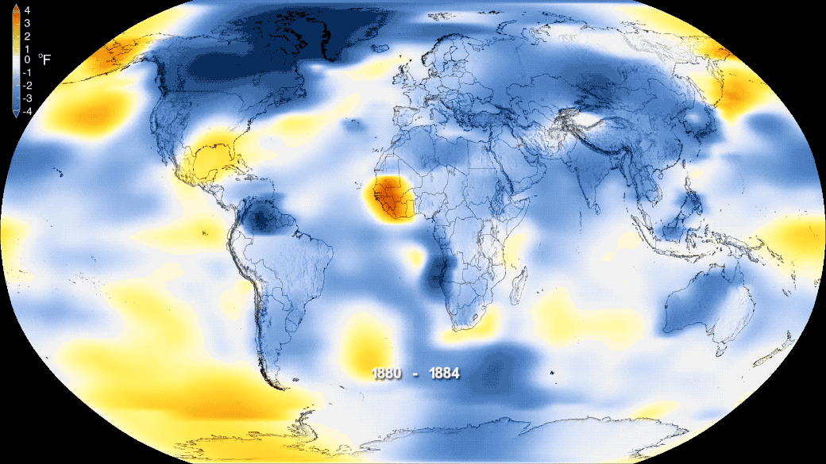
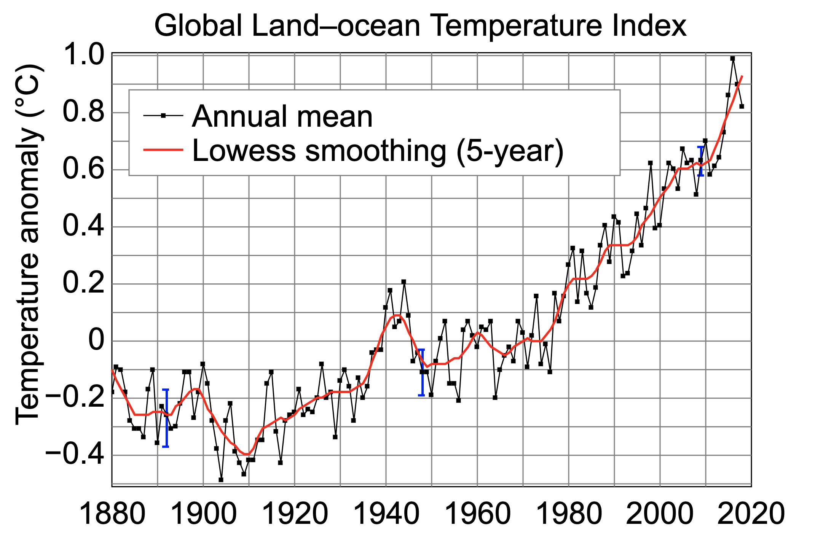
Climate Change in Recent Years
The Phenomenon of Climate Change:
Global Warming
Forest Degradation
Desertification
https://climate.nasa.gov/news/2876/new-studies-increase-confidence-in-nasas-measure-of-earths-temperature/
Notes:
We all know that climate change is one of the major problems being faced by mankind today.
The graphic on the left visualizes how the average temperature of earth has been on a rise for the last 150 years.

Slide 5
Proposals & Goals
To explore the trends of climate change in some cities in the United States by visualizing weather data over the past few decades.
To study the relationship between the geographical position and climatic correlation.
Take a deep-dive into San Diego’s weather.
Notes:
Through this project, we aim to explore the trends of climatic conditions in the US for the past 3 decades.
We have selected one of the most populous US cities to build our analysis upon.
We try to find correlation between Geographical position and different weather aspects before taking a deep dive into San-Diego’s weather study.

Slide 6
Data Collection and Preprocessing
/02

Slide 7
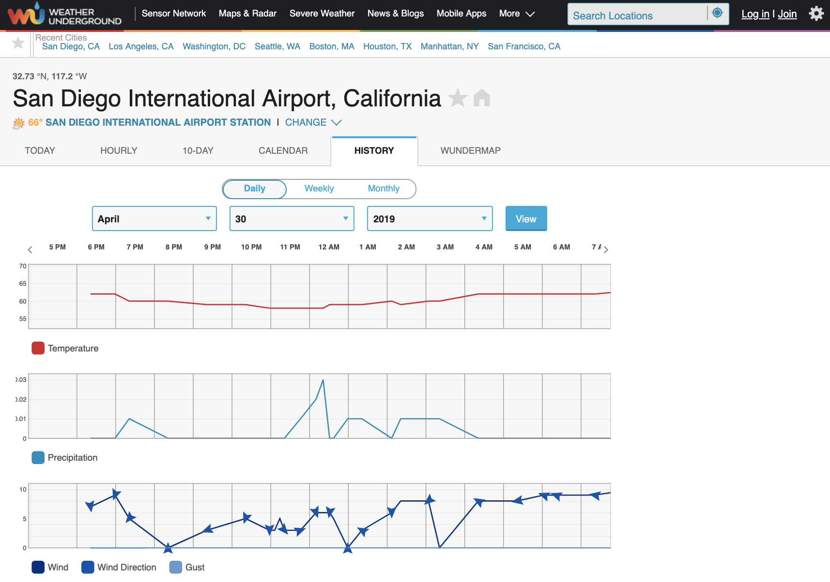
Weather Underground
link
A sensor network for weather information
Notes:
link
To collect weather information, a network of sensors is placed at various positions in a city and then the collected data is logged into the weather websites.
For this project, we formed our own dataset by scraping data from one such website.

Slide 8
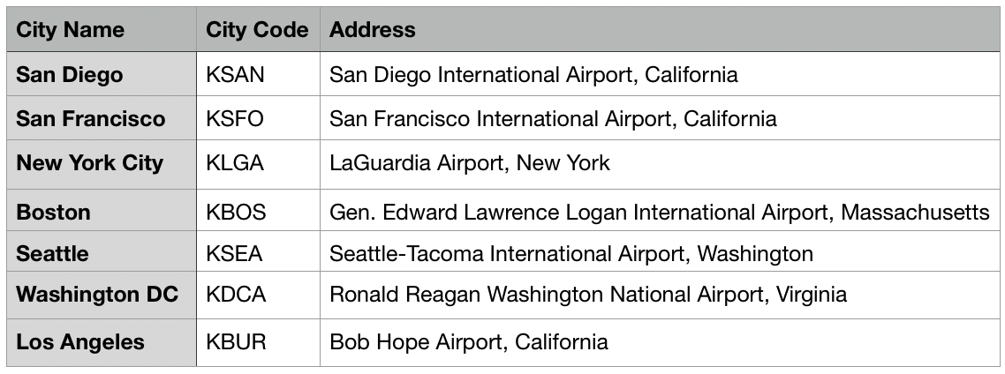
Data - City Code Reference
Notes:
The locations selected for the analysis along with the respective sensor location has been summarized in this table.

Slide 9
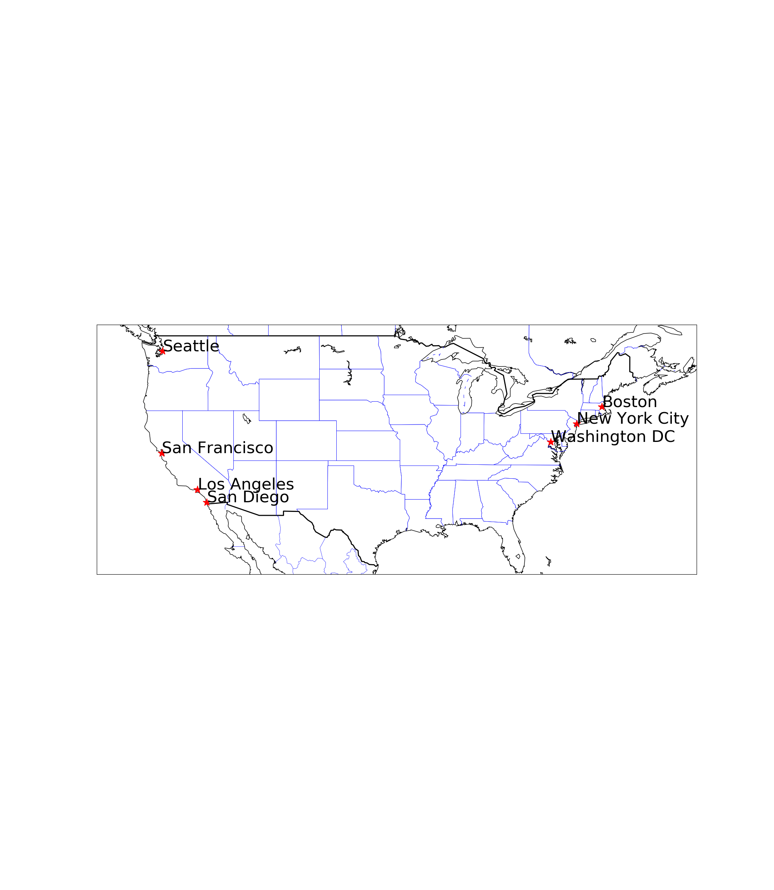
The Distribution of Selected Cities
Notes:
The selected cities are spread across the West coast and the East coast of the country.

Slide 10
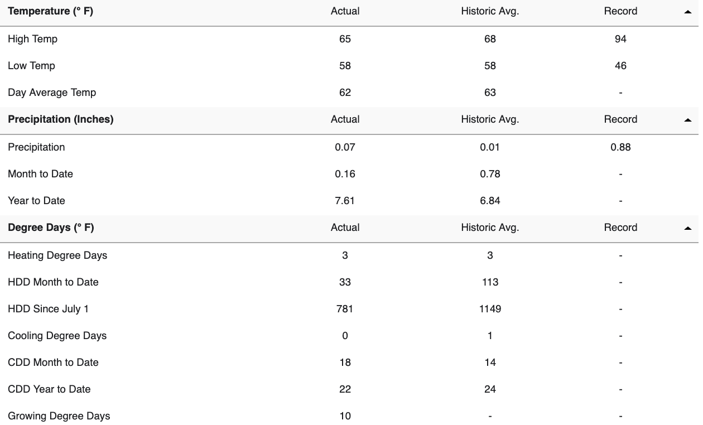
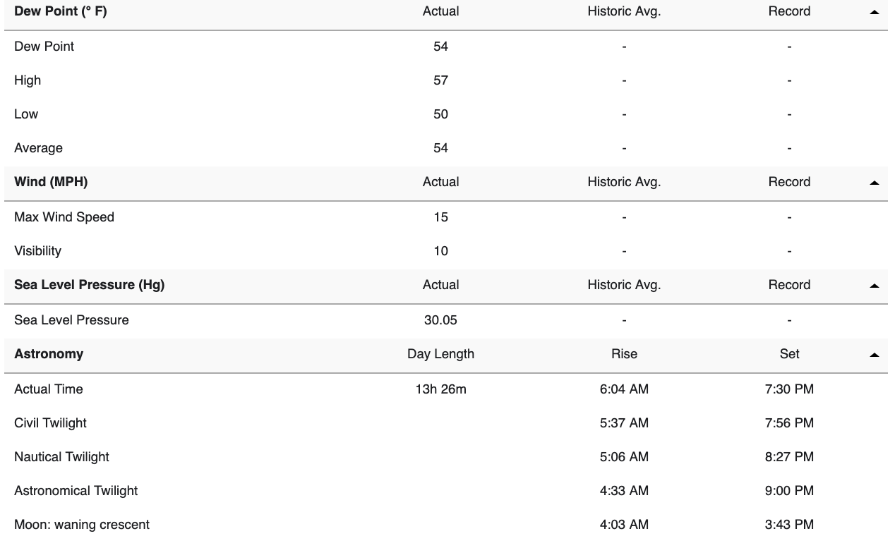
Data Summary
Notes:
As we can see, this website provides us a ton load of data for a single day!
We selected the data from 1990 onwards as the data available was more consistent for all the selected cities.

Slide 11
Data Selected
weather icon
Notes:
We worked on a few relevant columns such as the day-average temperature, precipitation and weather condition. One of the reasons for selecting these columns was that the data in these columns was more consistent than others.

Slide 12
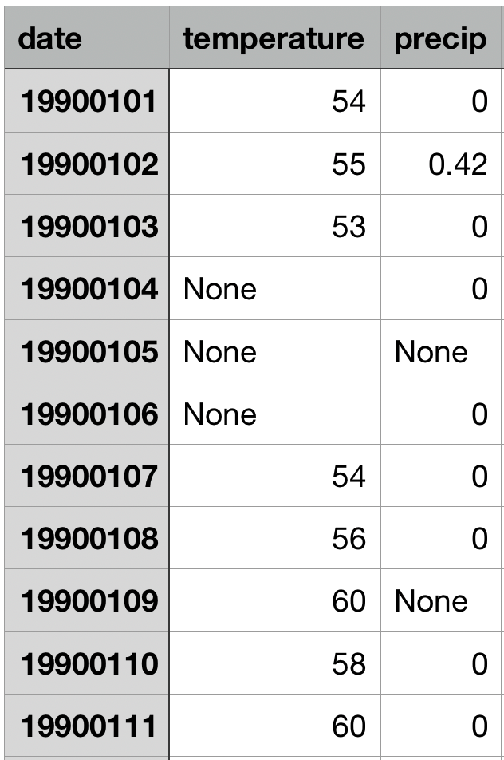
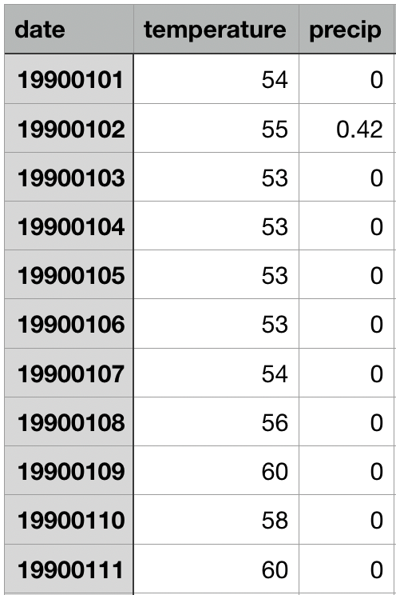
Data Cleaning
missing_values = ["n/a", "na", "--", None, 'None']
use forward-fill to fill the missing values:
pandas.DataFrame.fillna(method="ffill", inplace=True)
Notes:
for some cells where the data was not available, we used the forward fill method from pandas to compensate for the missing data

Slide 13
Comparison between West and East Coast
/03

Slide 14
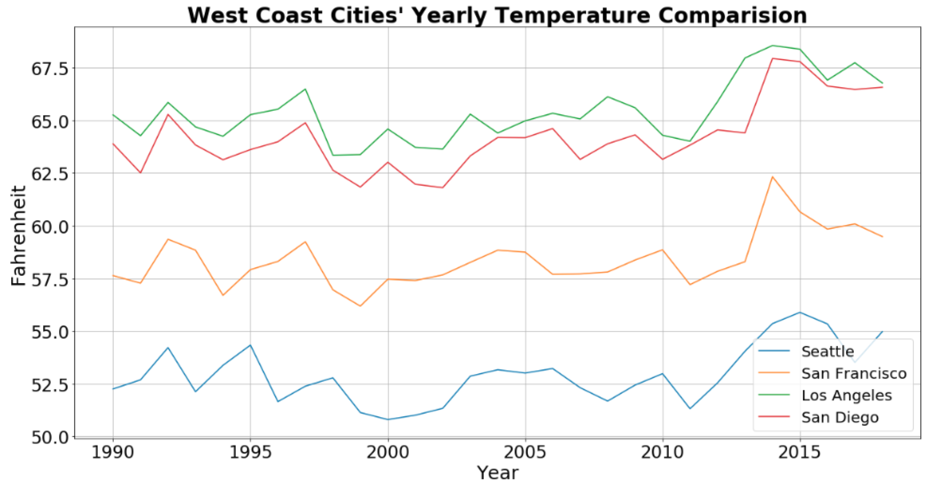
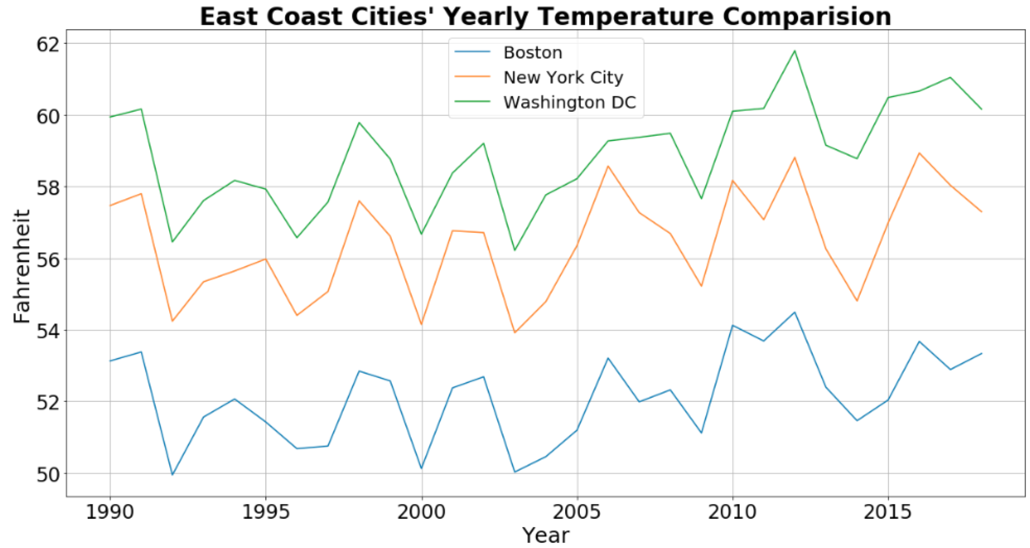
Average Temperature Comparison -- Year wise
Notes:
Obviously, as we move from South to North (top to bottom in the graphs), we see an expected decrease in temperature.
Cities in the same latitude on the east and west coasts (i.e. Boston and Seattle) have roughly the same range of temperature fluctuations.
Temperatures in all cities show an overall slightly upward trend.
Average temperature for the cities appears to be correlated, as shown in the next figure:

Slide 15
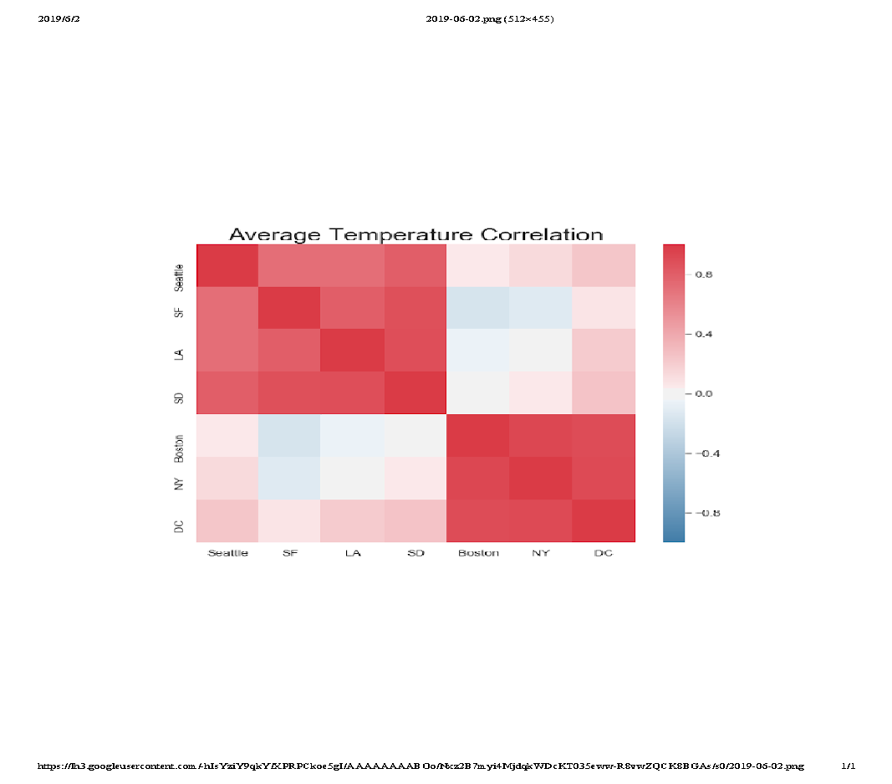
Average Temperature Correlation
West Coast Cities
East Coast Cities
Notes:
This correlation plot shows how distinctly the average temperature of the cities has been correlated based on the longitude.

Slide 16
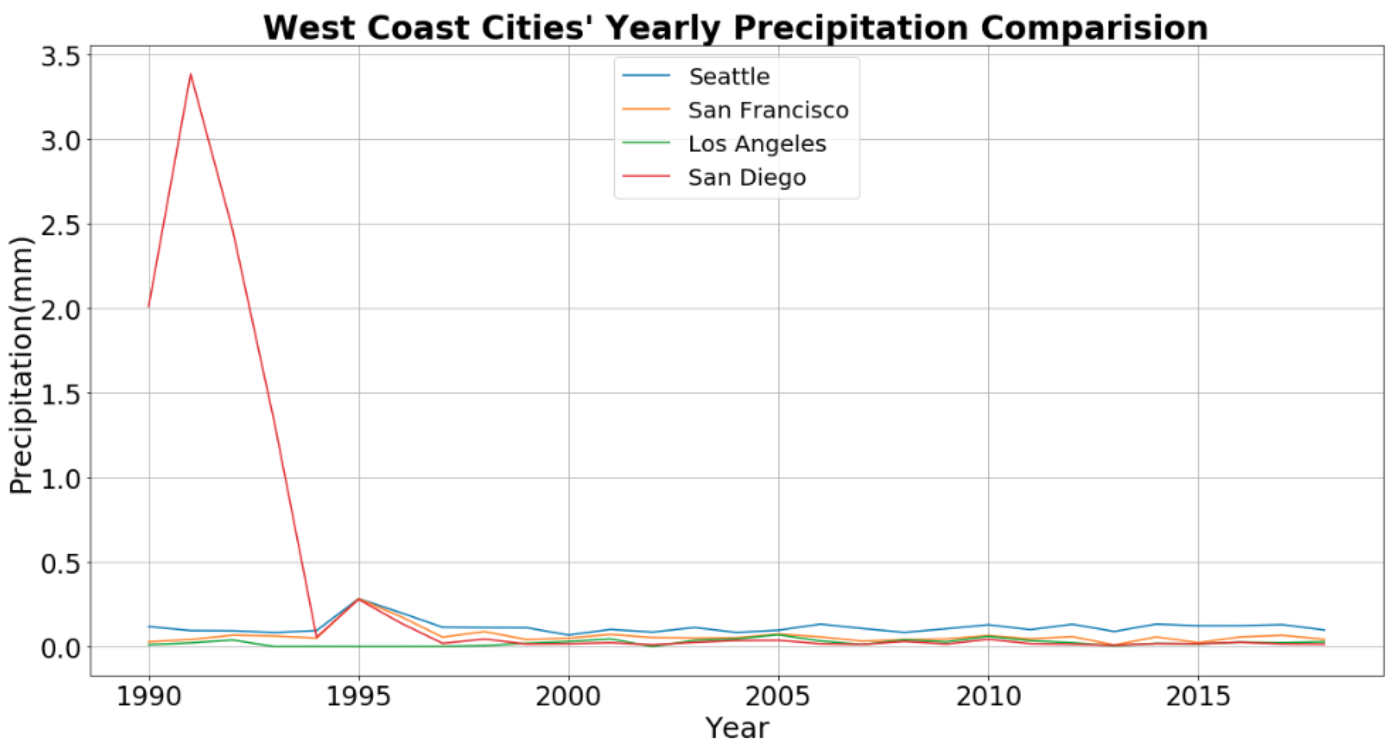
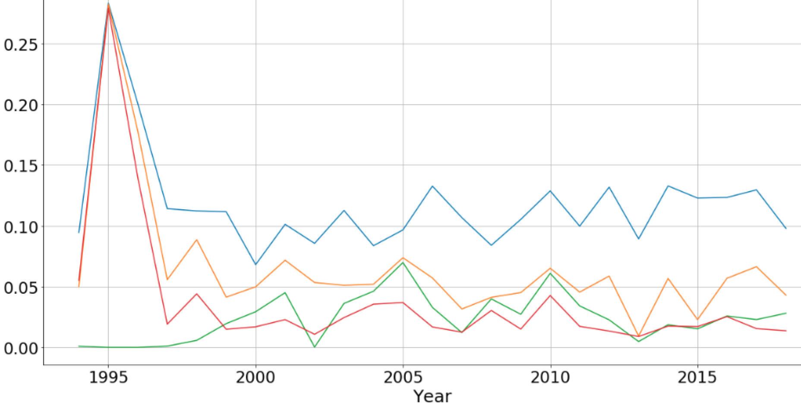
Average Precipitation Comparison -- Year wise (West Coast)
Notes:
We now move on to the average precipitation comparison. Owing to the arid conditions in Los Angeles and San Diego, the average annual rainfall is very low as compared to the Northern cities.
We can also see that the effect of arid conditions decrease as we move up north to Seattle.

Slide 17
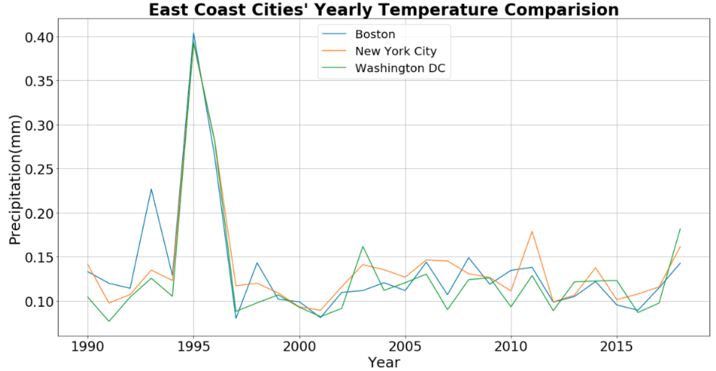
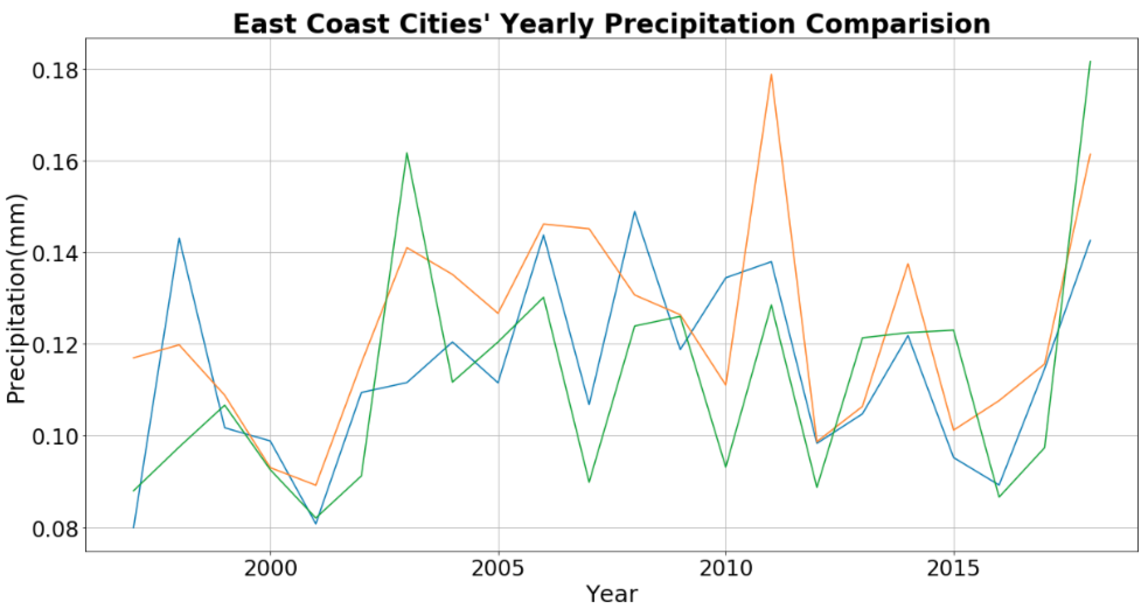
Average Precipitation Comparison -- Year wise (East Coast)
Notes:
The East Coast cities receive much heavier rainfall as compared to the west coast cities. Except for the year 1995, there is not a large variation in the average precipitation trend.

Slide 18
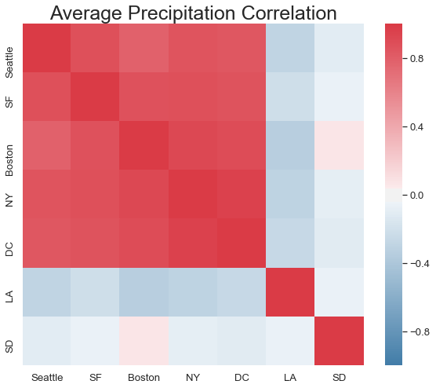
Average Precipitation Correlation
Arid Lands
Notes:
Except for the cities close to the Baja Desert, the yearly rainfall trend in the selected cities is pretty much correlated. However, as seen in the previous graphs, East coast receives much higher precipitation than the west coast.

Slide 19
Conclusions
The average temperature of the cities shows good correlation with respect to their longitude.
The average precipitation for the coastal cities on both coasts looks correlated, LA and SD being exception because of very less annual rainfall.

Slide 20
Data Visualization for San Diego
/04

Slide 21
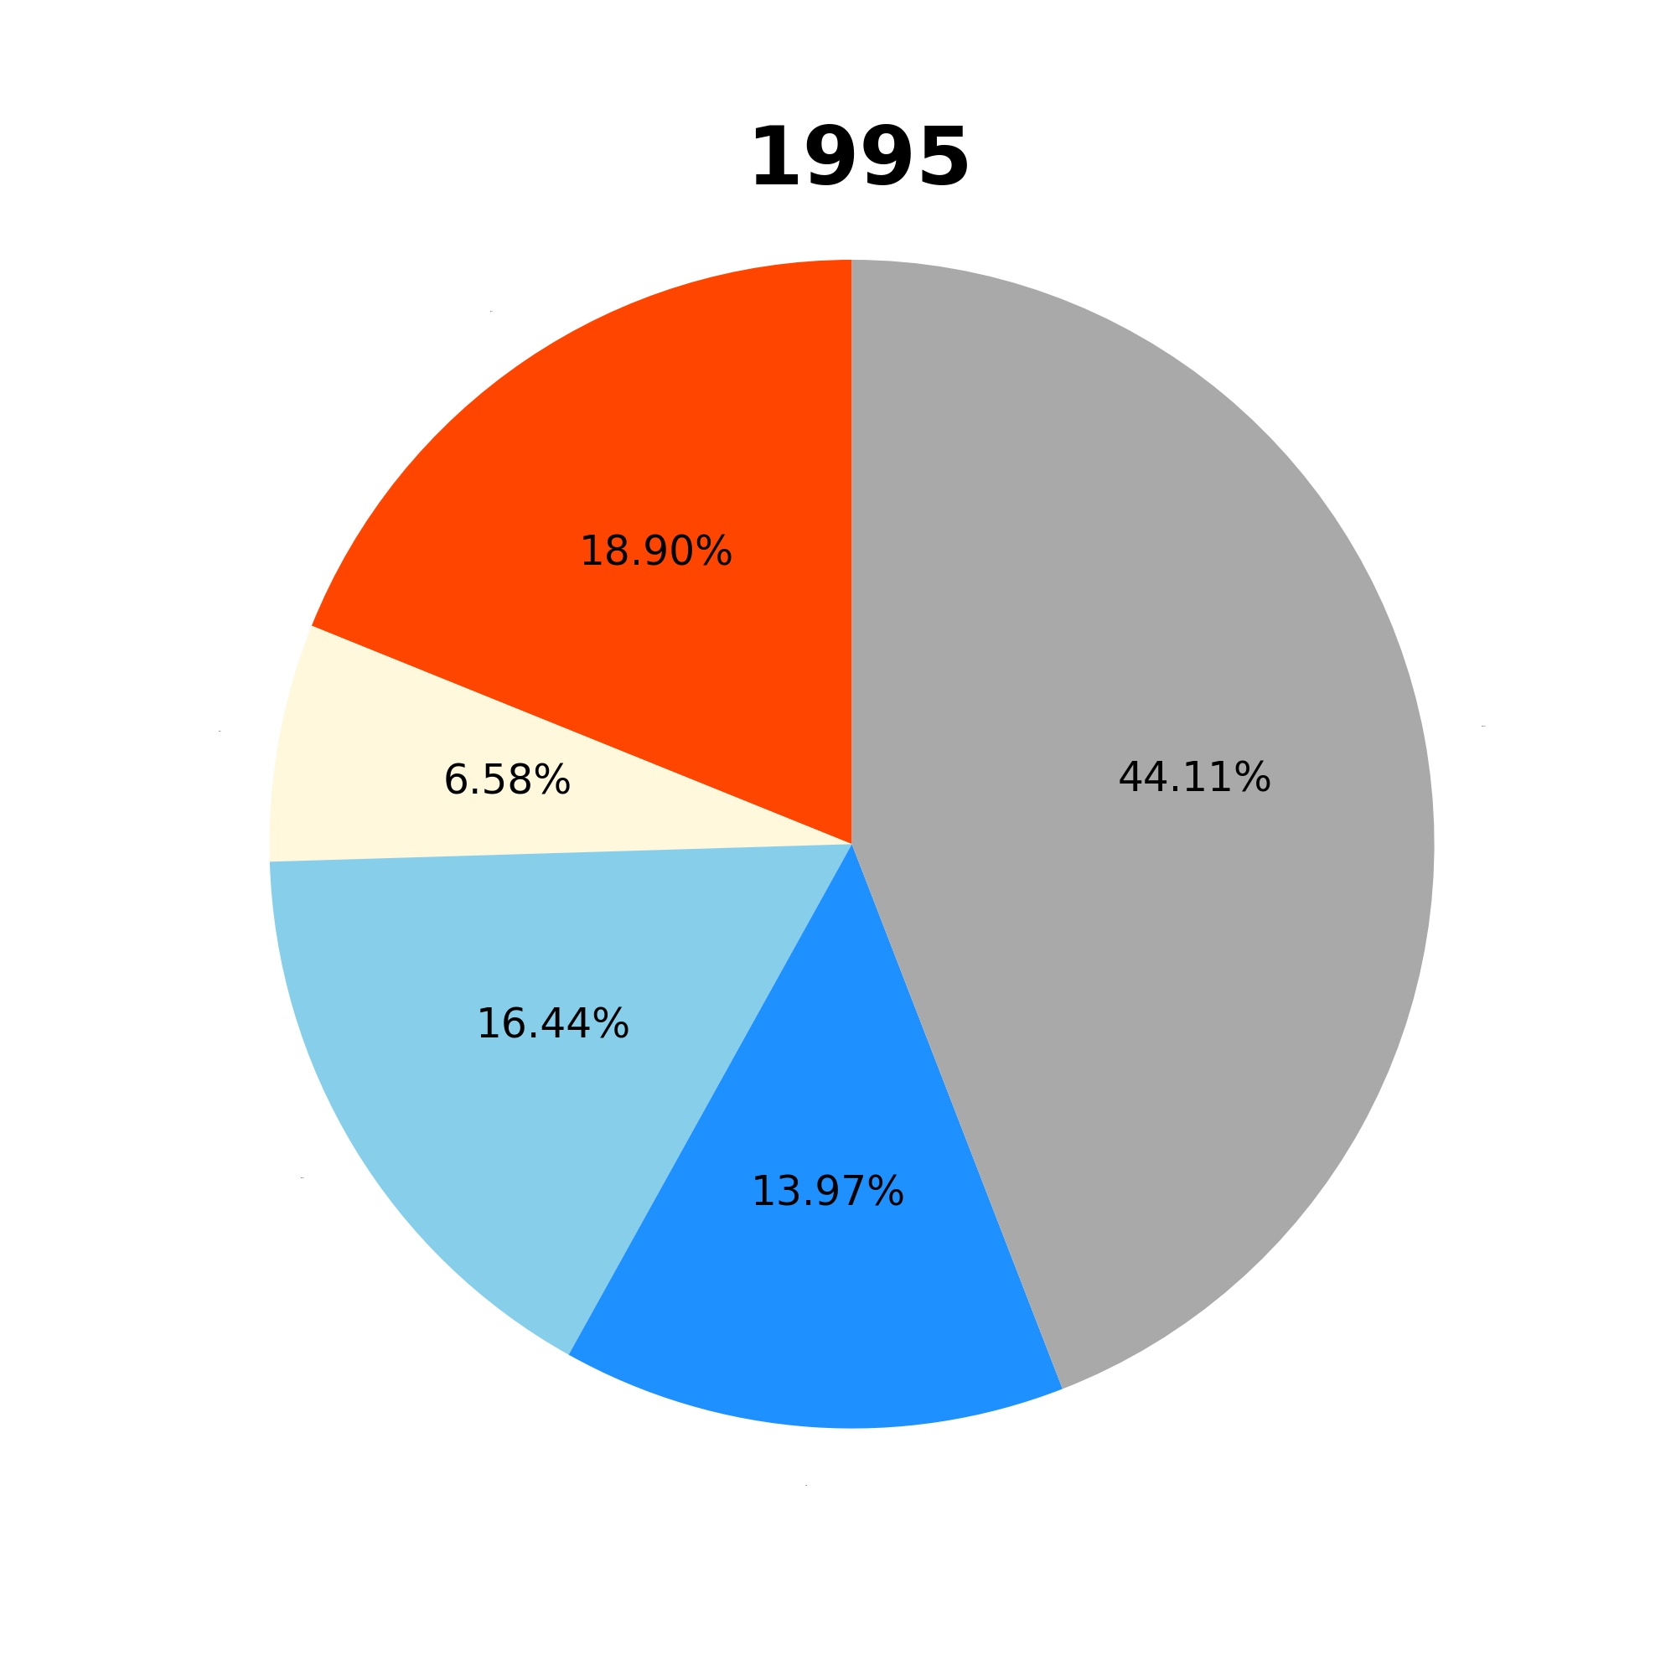
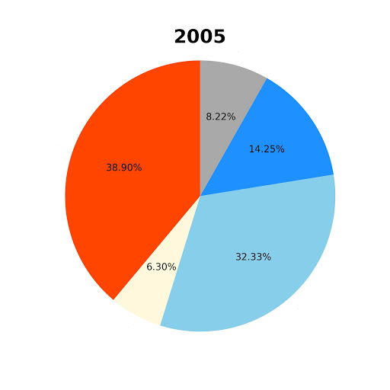
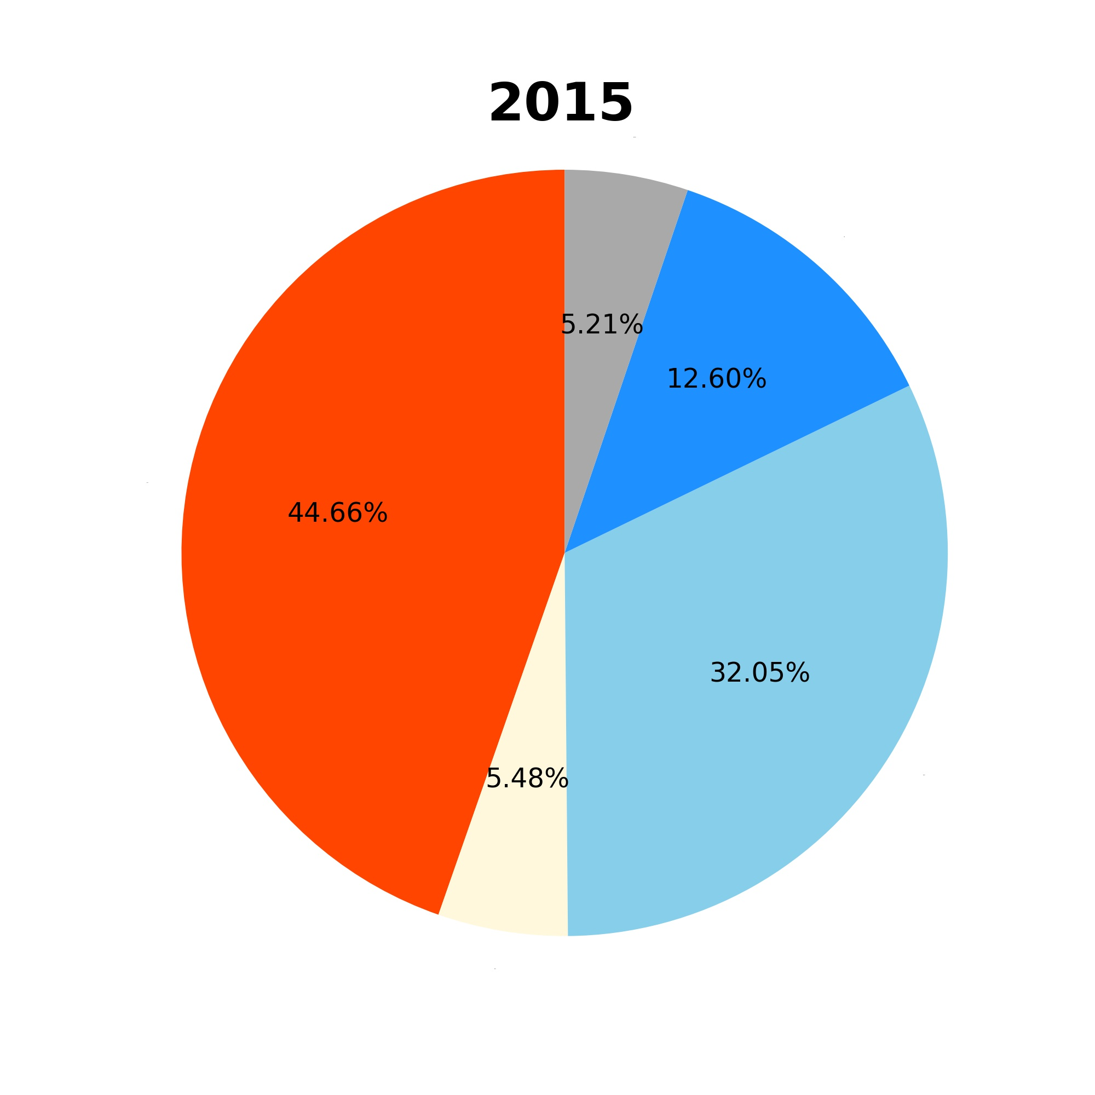
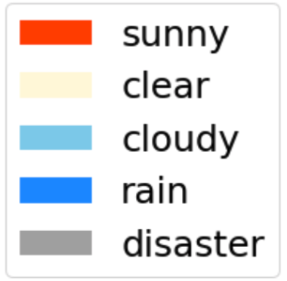
Weather of San Diego
Notes:
While we analyzed the yearly weather conditions of San Diego, we found that except mid 1990’s, San Diego’s weather has been pretty consistent for the past 28 years. The city has a lovely weather, being either sunny or clear for almost half of the year. The number of rainy days, let alone stormy days, is very less throughout the year.

Slide 22
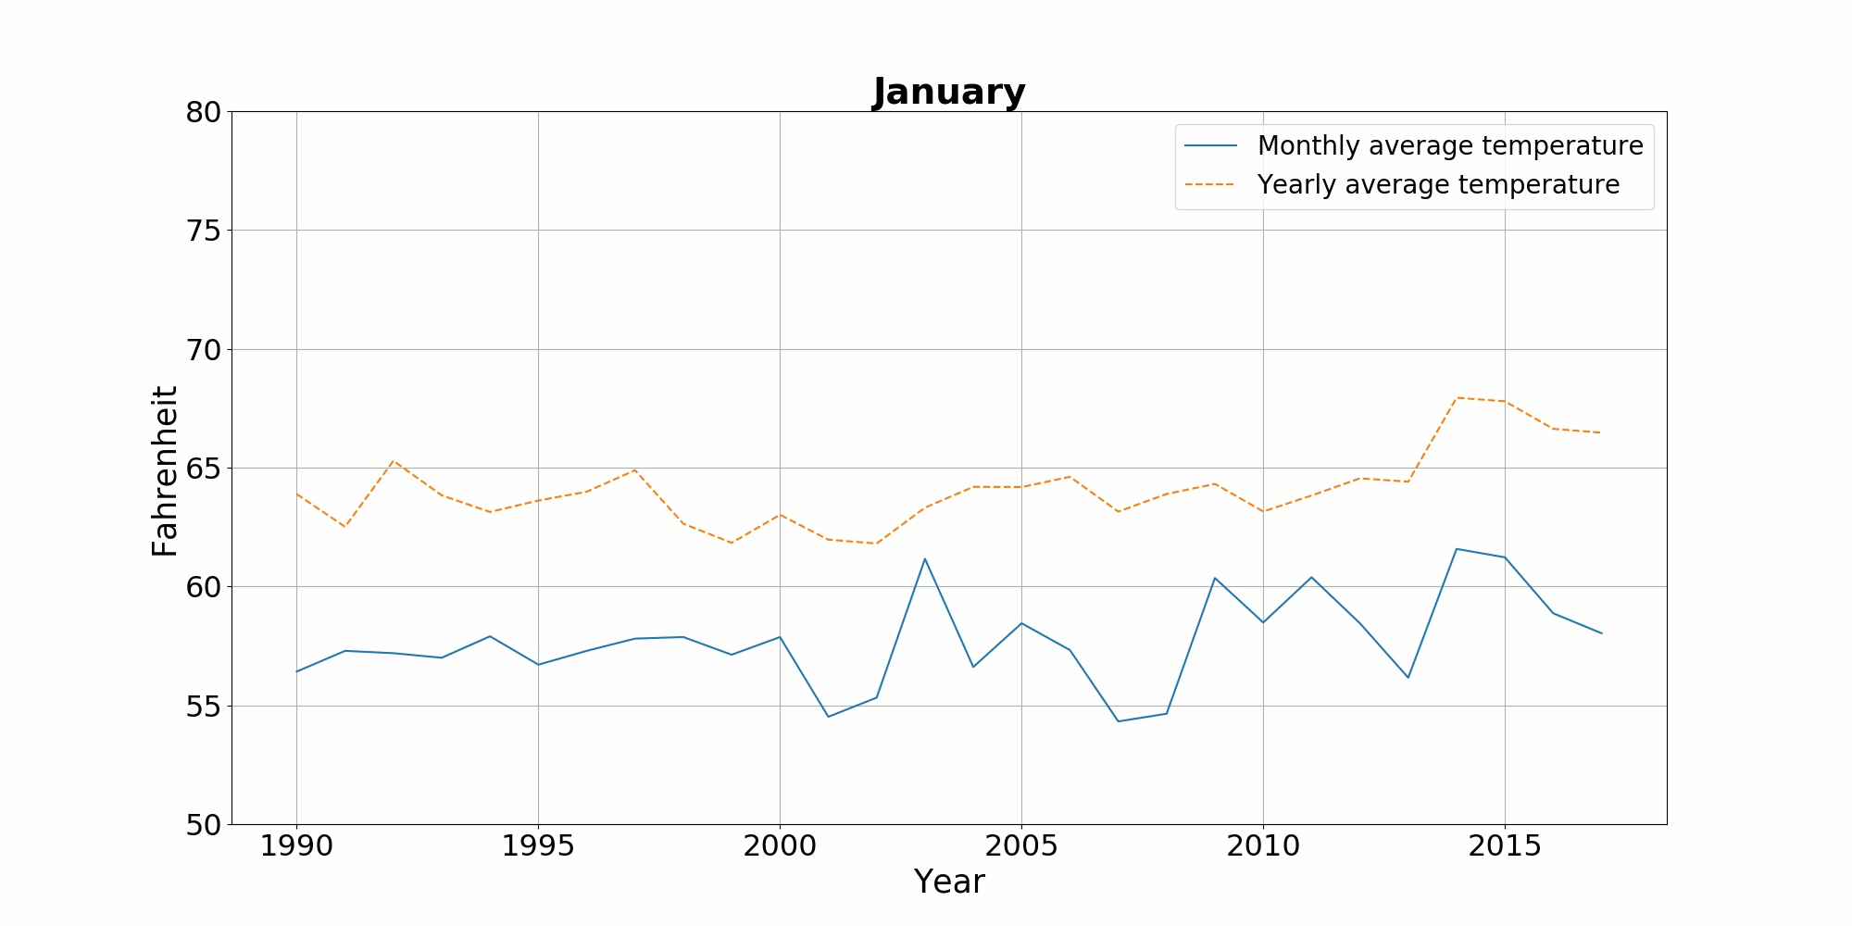
Average Temperature of San Diego (1990 - 2018)
Notes:
This plot shows the Monthly temperature of San Diego for the past 28 years as compared with the yearly average.
Through this GiF, we can see that the temperature peaks in the months of August and September. Overall, this graphic shows that the yearly average is on a rise and has gone up by almost 2.5 degrees in this time period.

Slide 23
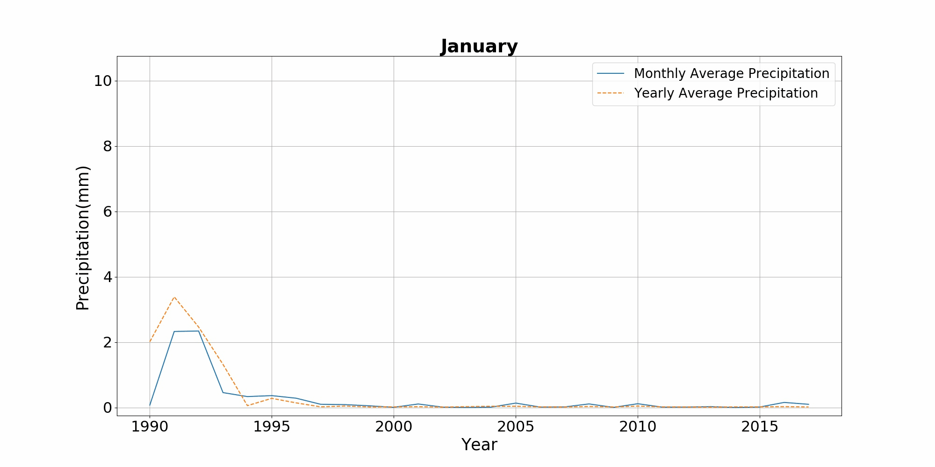
Average Precipitation in San Diego (1990 - 2018)
Notes:
The overall precipitation in San Diego is relatively small, mostly in the autumn and winter seasons.
At the same time, by visualizing the monthly precipitation, we can see that San Diego is a city with very small precipitation. But the precipitation data indicates that the year 1991 experienced some really extreme weather in the month of October, in 1991.

Slide 24
Conclusions
The average temperature per month in San Diego has fluctuated over the years but shows a slight upward trend overall.
The overall precipitation in San Diego is relatively small, mostly in the autumn and winter seasons.
Overall, San Diego is a city with moderate temperatures, mostly sunny days and less precipitation.
Notes:
The average temperature per month in San Diego has fluctuated over the years but shows a slight upward trend overall.
The overall precipitation in San Diego is relatively small, mostly in the autumn and winter seasons.
Overall, San Diego is a city with moderate temperatures, mostly sunny days and less precipitation.

Slide 25
Evaluations and Applications
/05

Slide 26
Evaluations and Applications
Since we don’t have an access to the comprehensive weather data for a longer duration of time, we are not able to make any comment on climate change in general.
Overall, this project can be used to get an overall picture of the weather conditions of a city, just by plugging in the city code.
Notes:
Show code?

Slide 27
Thanks!

